Slide 1
MetricStream – Non-conformance and
MetricStream – CAR/SCAR
Introduction to:
Version 1.8

Slide 2
Click to Explore:
What are MetricStream – Non-conformance
and MetricStream – CAR/SCAR?
Why MetricStream?
Benefits
Functional Overview
Technical Overview
Implementation
Click here on any slide to return to this page.

Slide 3
What are
MetricStream – Non-conformance
and
MetricStream – CAR/SCAR?

Slide 4
Cummins Quality Management Solutions
The term “Cummins Quality Management Solutions”, or CQMS, refers to a group of key quality functions and the various software tools that support those functions.
Each software application enables and facilitates better control of Cummins’ quality management processes.

Slide 5
The Goal of CQMS
“For key processes -
the right way to do the work
is the only way to do the work worldwide.”
-- Tom Linebarger

Slide 6
Cummins Quality Management Solutions
The red circles represent
the key quality functions
MetricStream – CAR/SCAR (QSi for non-MetricStream sites)
Cummins Quality Management Solutions
(CQMS)
Corrective Action / Supplier Corrective Action
Document Control
Audits/ Assessments
Statistical Process Control
Process Failure Mode and Effects Analysis
Six Sigma Database
RPS Database
PPAP
Gauge Management
Statistics
Material and Process Non-conformance
MetricStream –
Non-conformance (QSi for non-MetricStream sites)
Minitab
The tools supporting these
functions are listed in black
Maximo
QSi
GPS – PPAP
(EBU/Fuel Systems)
MetricStream – PPAP
(all other BUs)
QSi
GE Fanuc
(was Visual SPC)
Lotus Notes
6
Lotus Notes
EASE

Slide 7
The MetricStream Suite
Several of the CQMS tools on the previous slide have been developed by MetricStream, an external vendor.
These tools all share the same look and feel, and are collectively known as the MetricStream Suite.

Slide 8
The MetricStream Suite
MetricStream – Non-conformance
MetricStream Suite
Material and Process Non-conformance
Customer Quality Module
Corrective Action / Supplier Corrective Action
PPAP
MetricStream – CAR/SCAR
MetricStream – PPAP
(all BUs except EBU and Fuel Systems)
MetricStream – CQM
(in development)
8

Slide 9
In Other Words...
MetricStream – Non-conformance is the software tool that manages Material and Process Non-conformance
MetricStream – CAR/SCAR is the software tool that manages Corrective and Supplier Corrective Action Requests
Both tools are part of the MetricStream Suite, which is a key component of CQMS

Slide 10
Why MetricStream?

Slide 11

The Goal of the Quality Function
“It is our responsibility to assure continuous improvement towards defect-free processes that satisfy customer needs and achieve business results.”
George Strodtbeck
Executive Director –Quality and COS

Slide 12
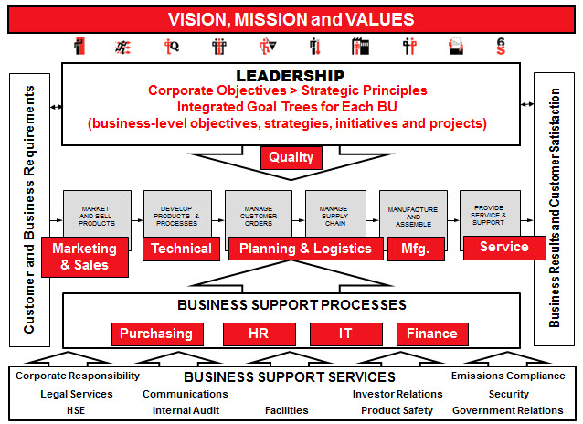
Quality at Cummins
Quality is a part
of everything we do

Slide 13
Cummins Operating System
The Cummins Operating System (COS) is the framework for how work happens at Cummins
Customer satisfaction and business results come from the interaction of processes across businesses and functions
These interactions determine the quality of results
The tools in the MetricStream Suite are enablers for COS
  Key process-focused

Slide 14
Benefits

Slide 15
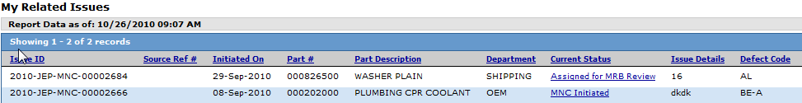
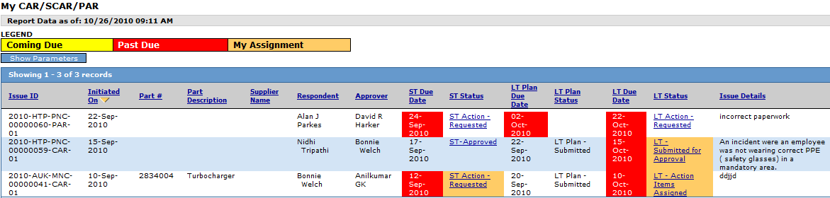
Benefits to the Site
Allows real-time visibility and communication within the plant and with suppliers on their quality issues
Makes it easier to find inter- and intra-site repeat issues
Using site-defined fields, lets plants define their own values which provides meaningful data in reporting
Provides easier tracking of non-conformances and corrective actions through reports and dashboards
15

Slide 16
Benefits to the Quality Organization
Drives common quality processes across the Cummins enterprise
Improves overall product quality through:
  collecting /tracking quality issues with a consistent process
  speeding up the supplier response process
  viewing rolled-up BU and enterprise data to spot trends
Increases quality awareness across the company and with suppliers through:
  real-time email notifications
  easy data access through dashboards and reports

Slide 17
Benefits to the IT Organization
Simplifies management and support through a central instance
Complies with Cummins IT architecture and security standards including:
  Single Sign-On (SSO) using LDAP
  Oracle database and data warehouse initiatives
Eliminates data redundancy via Master Source interfaces for Part, Supplier, and Customer data
Standard and custom analysis and reporting available soon through the Oracle Business Intelligence tool (OBIEE)

Slide 18
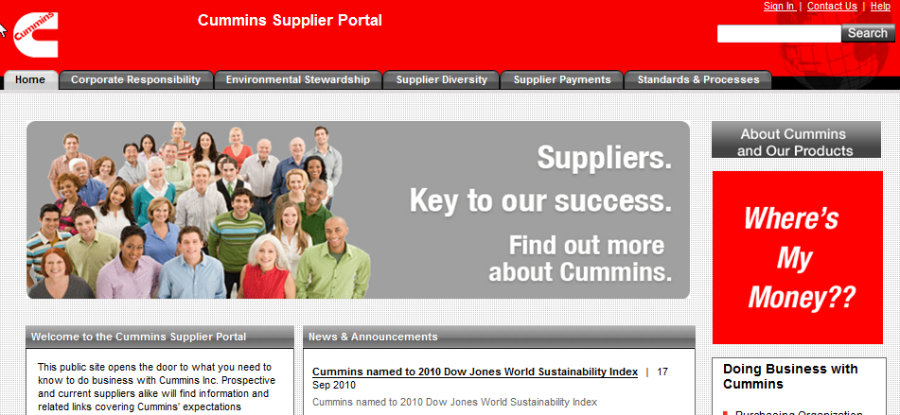
Benefits to Suppliers
Real-time notification of pending quality issues, allowing fast communication and response
Consistent process to respond to all Cummins supplier non-conformances and SCARs
Data privacy and security
Accessible through the Cummins Global Cummins Supplier Portal

Slide 19
Training and Support
Interactive training, Quick Reference Guides, “getting help” instructions and more are available on the MetricStream Learning Center website (it is accessible outside of the Cummins network):
  cqms.cummins.com/training/training.html
Monthly user, admin, and supplier training sessions are conducted via teleconference and WebEx
The Cummins MetricStream team has members located in India, U.K. and the U.S. to provide infant care and long-term support virtually around the clock

Slide 20
Functional Overview

Slide 21
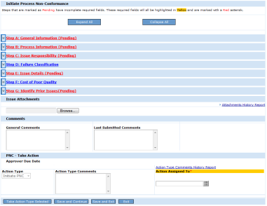
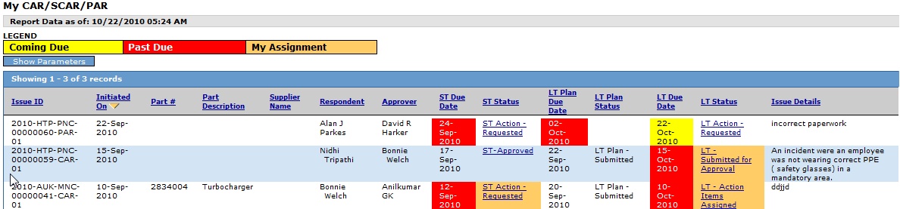
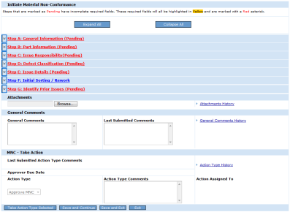
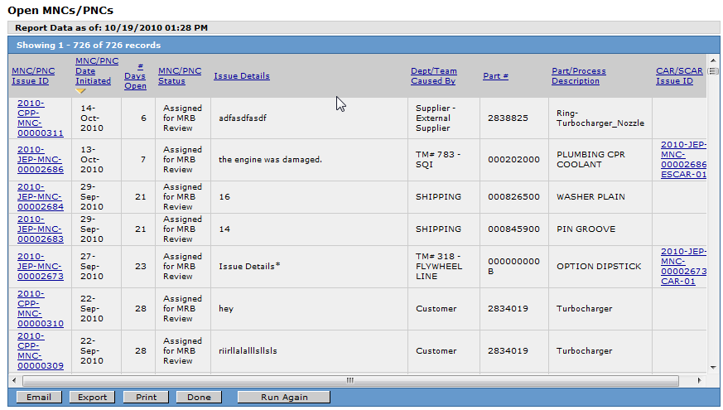
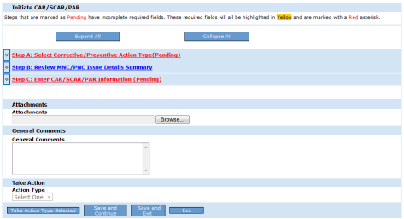
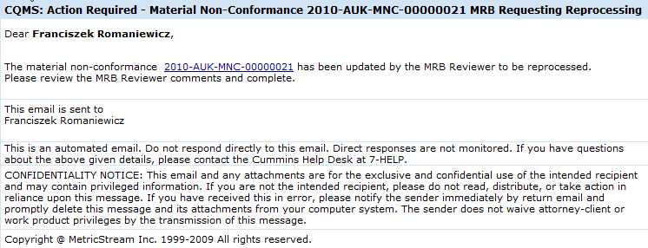
Inputs and Outputs
Process
Non-conformances
Non-conformance
Dashboards
Material
Non-conformances
MetricStream
Reports
Corrective Action Requests
CAR/SCAR
Email Notifications
Supplier
Corrective Action Requests

Slide 22
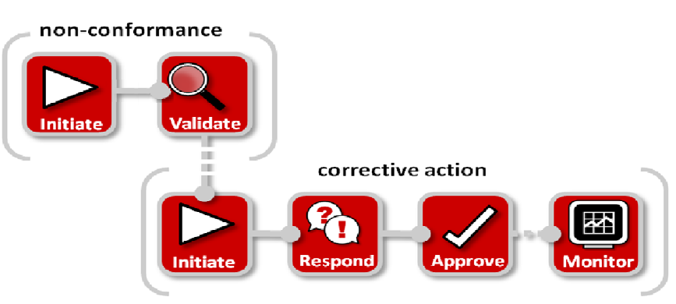
High-level Functional Overview

Slide 23

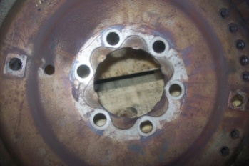

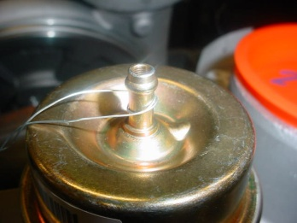
Common Process
Step 1
Non-Conformance
Optional
PNCs
MNCs
Step 2
Corrective Action
CARs
SCARs
Process Failures
Material Defects

Slide 24


Basic PNC Flow
Step 1
Non-Conformance
PNCs
MNCs
Initiate PNC
PNC Initiator
Validate PNC
PNC Approver(s)

Slide 25
Supplier PNC Flow
Step 1
Non-Conformance
PNCs
Initiate PNC
PNC
Initiator
Validate PNC
PNC Approver(s)
Supplier Response
Supplier Contact(s)

Slide 26
Basic MNC Flow
Step 1
Non-Conformance
PNCs
MNCs
Initiate MNC
MNC
Initiator
Validate MNC
MNC
Approver(s)
MRB Review
MRB Reviewer(s)

Slide 27
MNC with Waiver Flow
Step 1
Non-Conformance
MNCs
Initiate MNC
MNC
Initiator
Validate MNC
MNC
Approver(s)
Waiver*
Waiver Approver(s)
MRB Review
MRB Reviewer(s)
*With Waivers, a second level of approval
is optional.

Slide 28
Supplier MNC Flow
Step 1
Non-Conformance
MNCs
Initiate MNC
MNC
Initiator
Validate MNC
MNC
Approver(s)
Supplier Response
MRB Review
Supplier Contact(s)
MRB Reviewer(s)

Slide 29
Basic CAR Flow
Optional
Step 2
Corrective Action
Step 1
CARs
SCARs
PNC or MNC
Initiate CAR
CAR
Initiator
Short Term
Long Term
Respondent
Approve
Approve
CAR
Approver

Slide 30
CAR with Monitoring Flow
Step 2
Corrective Action
CARs
Step 1
PNC or MNC
Initiate CAR
CAR
Initiator
Effectiveness Checker
Short Term
Long Term
Unsuccessful
Respondent
Approve
Approve
Monitor
CAR
Approver
Successful

Slide 31
Basic SCAR Flow
Step 2
Corrective Action
CARs
SCARs
Step 1
PNC or MNC
Initiate SCAR
SCAR
Initiator
Short Term
Long Term
Respondent(s)
Approve
Approve
Corp
Purchasing
SQIE
SCAR
Approver
Approve
*SCARs can be issued to external
(non-Cummins) suppliers or Cummins
internal suppliers.
SCAR
Approver

Slide 32
SCAR with Monitoring Flow
Step 2
Corrective Action
CARs
SCARs
Step 1
PNC or MNC
Initiate SCAR
SCAR
Initiator
Effectiveness Checker
Short Term
Long Term
Unsuccessful
Respondent(s)
Approve
Approve
SCAR
Approver
Corp
Purchasing
SQIE
Approve
Monitor
SCAR
Approver
Successful

Slide 33
Functional Flexibility
Related (repeat) non-conformances can be tied into a single corrective action...
Step 1
2010-JEP-MNC-00001234
Step 1
2010-JEP-MNC-00001382
2nd Repeat MNC
Step 1
Step 2
2010-JEP-MNC-00001732
Initiate CAR
2010-JEP-MNC-00001732-CAR-01
Also related to:
2010-JEP-MNC-00001234
2010-JEP-MNC-00001382

Slide 34
Functional Flexibility
Conversely, a single non-conformance can trigger multiple related corrective actions:
Step 1
Step 2
Completed PNC
2010-JEP-PNC-00001253
Initiate CAR
2010-JEP-PNC-00001253-CAR-01
Initiate CAR
2010-JEP-PNC-00001253-CAR-02
Initiated CAR
2010-JEP-PNC-00001253-CAR-03

Slide 35
Technical Overview

Slide 36
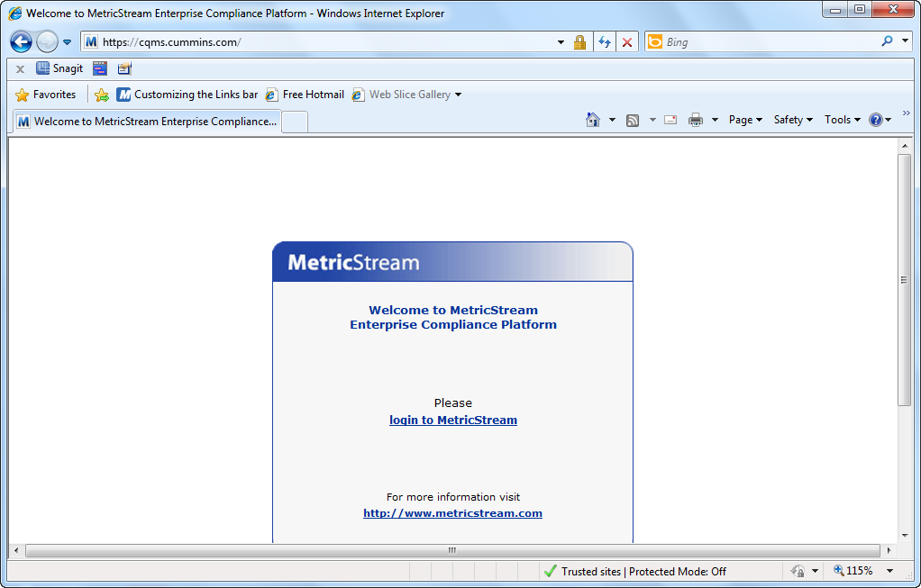
System Information
Web-based, vendor-developed application
  Certified on Internet Explorer 7 & 8
Single instance hosted on Cummins architecture
  WebSphere, Single Sign-on, Oracle backbone, etc.

Slide 37
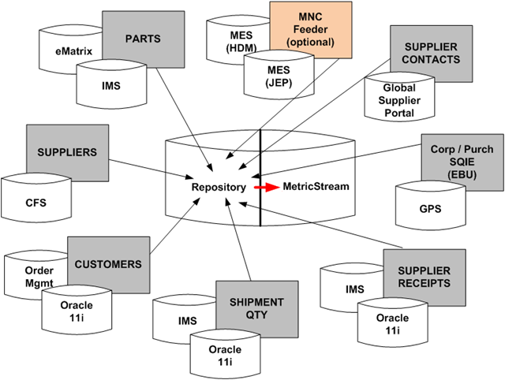
Interfaces
In order to maintain consistency, the system relies on interfaces with several authoritative source systems:

Slide 38
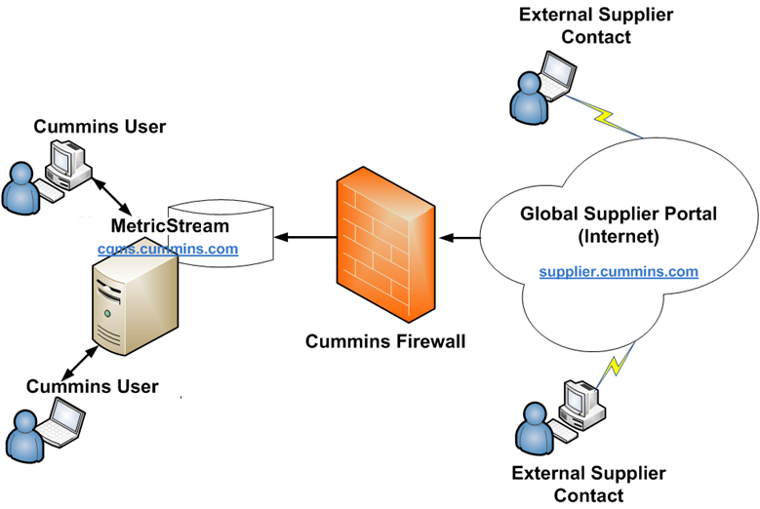
System Layout

Slide 39
Implementation

Slide 40
High-level Implementation Process
Detailed project plans are available, but at a high level, MetricStream – Non-conformance and MetricStream – CAR/SCAR implementation follows a unique M-gate methodology (developed as an output of two 6S projects):
M0 - Identify Stakeholders, Short Intro, Budget and High-level Schedule
M1 - Supplier, SQIE, Supplier Contact Identification and Registration
M2 – Long Intro, Site Definition, Master Data Source Identification
M3 - Site Configuration
M4 - Interface Development
M5 - Training and Staging
M6 – Go-live and Infant Care

Slide 41
Next Steps
Begin identification of direct active suppliers
Begin identification of supplier contacts and start registration
Schedule and hold the long introduction meeting with identified key stakeholders

